Slide 1
New(b) Adults:
A Needfinding Study
Mayowa Adesina, Esaw Adhana, Butch Nasser, Tina Zheng

Slide 2
But first, who are we?

Slide 3
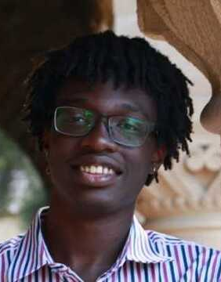
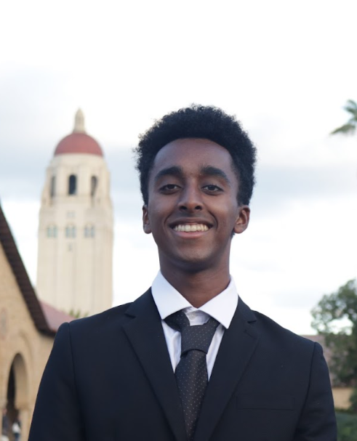
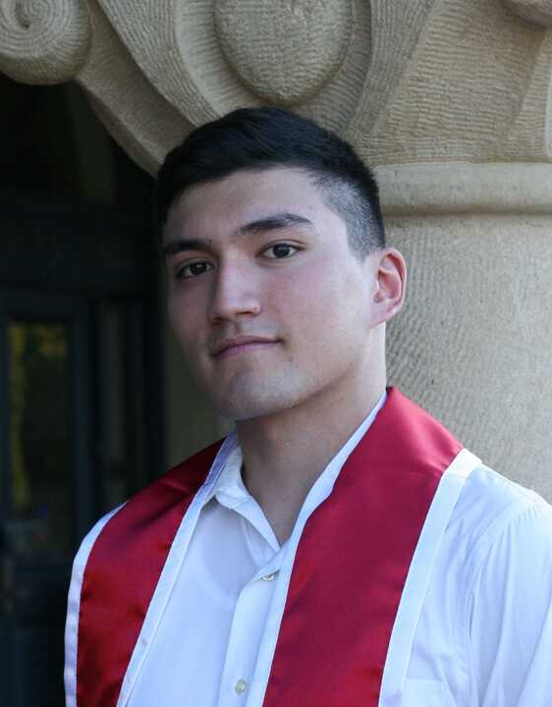
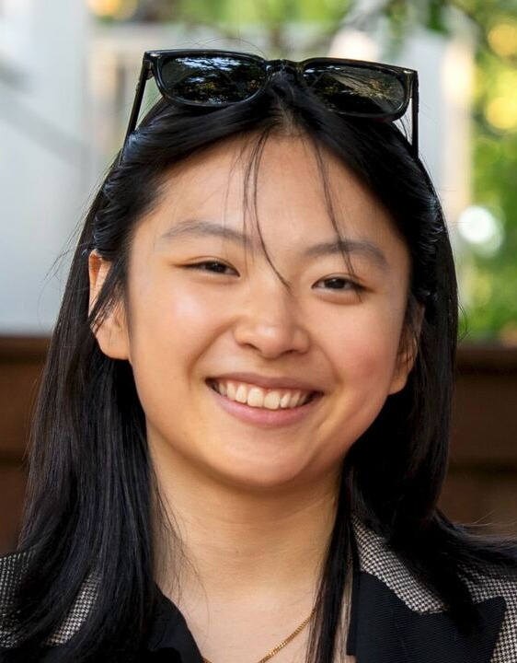
But first, who are we?
Mayowa Adesina
Esaw
Adhana
Butch
N
Tina
Zheng
CS, Class of ‘27
CS, Class of ‘27
CS (HCI), Coterm
SymSys, Class of ‘26

Slide 4
Our problem domain:

Slide 5
Our problem domain:
“Individuals transitioning to independent living for the first time”
Notes:
Mention how we were bouncing around a bit on how to encapsulate it.

Slide 6
Our problem domain:
“Individuals transitioning to independent living for the first time”
Includes:
New grads (ie. individuals leaving the school system)

Slide 7
Our problem domain:
“Individuals transitioning to independent living for the first time”
Includes:
New grads (ie. individuals leaving the school system)
AND

Slide 8
Our problem domain:
“Individuals transitioning to independent living for the first time”
Includes:
New grads (ie. individuals leaving the school system)
AND
Individuals who didn’t attend/graduate from a 4-year college
(eg. college dropouts, trade school grads, direct high school → military enlistees, etc.)

Slide 9
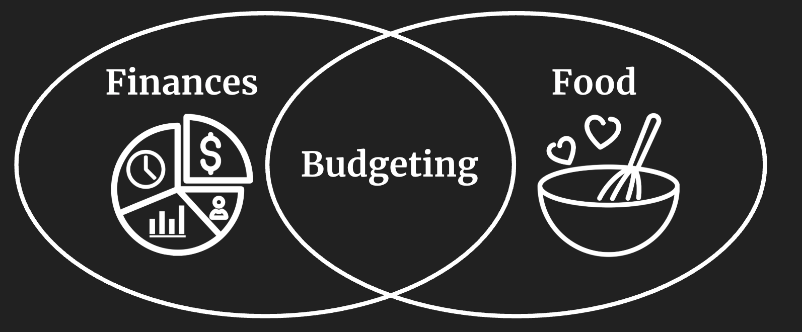
Our problem subdomains:

Slide 10
Our problem subdomains:

Slide 11
Our problem subdomains:

Slide 12
Our problem subdomains:
Notes:
Our questions generally focused on these two subdomains…

Slide 13
(Some of) What we asked:
What were some surprises you encountered when first providing food for yourself?
If you eat out, what usually leads you to eat out instead of cooking?
Are you currently financing any large purchases? Any remarks?
What are your thoughts on debt?
How do you decide which groceries to buy each week?
Where do you usually shop for groceries, and how did you pick that place?
What do you wish you knew earlier about finances?
Notes:
Here are some of the kinds of questions we asked, and as you can see, as I said before, in the domains of food and finances.

Slide 14




Our participants
“Lillian”
“Nora”
“Lucy”*
“Samantha”
Class of ‘25, in music/entertainment industry, lives in Richmond district in SF
Class of ‘26 (UC Berkeley senior) studying film, studied abroad in Japan for a year
Class of ‘25, current startup co-founder, international student, attended boarding HS
Class of '22, current software engineer at Pinterest (full-time), lives in SoMa district in SF
*extreme user
Participants were audio-recorded.
Notes:
We chose these participants because they are individuals with experience transitioning into independent living for the first time. We recorded audio and generally took handwritten notes. Lucy is an extreme user because she started independent living much earlier on in life than the average person.

Slide 15
Recruitment + Compensation
“Lillian”
“Nora”
“Lucy”
“Samantha”
Recruited through coworker from a former internship.
Compensated with a drink from a cafe.
Recruited by a Berkeley friend in a technical discord server. Compensated with a meal prior to interview.
Recruited from WeChat through help of an international student.
Compensated with a meal prior to interview.
Recruited through girlfriend’s sister
(through Tina).
Compensated with a drink from a cafe.

Slide 16
Notes:
Now, let’s move on to what we discussed in our interviews!

Slide 17
Notes from Lillian

Slide 18
Notes from Lillian
Chose to conduct interview at cafe known for creativity/design

Slide 19
Notes from Lillian
Chose to conduct interview at cafe known for creativity/design
Grew up in Alameda
  Parents handled everything

Slide 20
Notes from Lillian
Chose to conduct interview at cafe known for creativity/design
Grew up in Alameda
  Parents handled everything
  Admitted being “stagnant” and “sheltered”
    College was a harsh transition

Slide 21
Notes from Lillian
Chose to conduct interview at cafe known for creativity/design
Grew up in Alameda
  Parents handled everything
  Admitted being “stagnant” and “sheltered”
    College was a harsh transition
Felt very welcomed when studying abroad in Italy

Slide 22
Notes from Lillian
Chose to conduct interview at cafe known for creativity/design
Grew up in Alameda
  Parents handled everything
  Admitted being “stagnant” and “sheltered”
    College was a harsh transition
Felt very welcomed when studying abroad in Italy
  Helped her experiment more/try new things

Slide 23
Notes from Lillian
Chose to conduct interview at cafe known for creativity/design
Grew up in Alameda
  Parents handled everything
  Admitted being “stagnant” and “sheltered”
    College was a harsh transition
Felt very welcomed when studying abroad in Italy
  Helped her experiment more/try new things
    Contradiction: After enjoying trying a lot of Italian food, went out of her way to find more familiar food

Slide 24
Notes from Lillian
Chose to conduct interview at cafe known for creativity/design
Grew up in Alameda
  Parents handled everything
  Admitted being “stagnant” and “sheltered”
    College was a harsh transition
Felt very welcomed when studying abroad in Italy
  Helped her experiment more/try new things
    Contradiction: After enjoying trying a lot of Italian food, went out of her way to find more familiar food
  Interested in bringing the community aspect of food in Italy back to the States

Slide 25
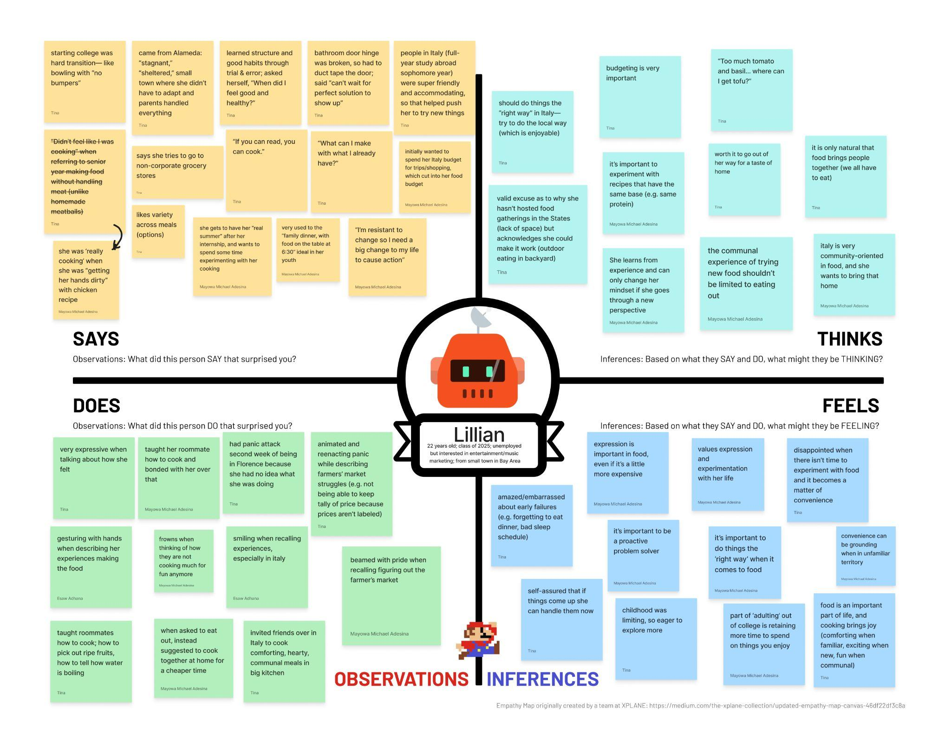

Slide 26
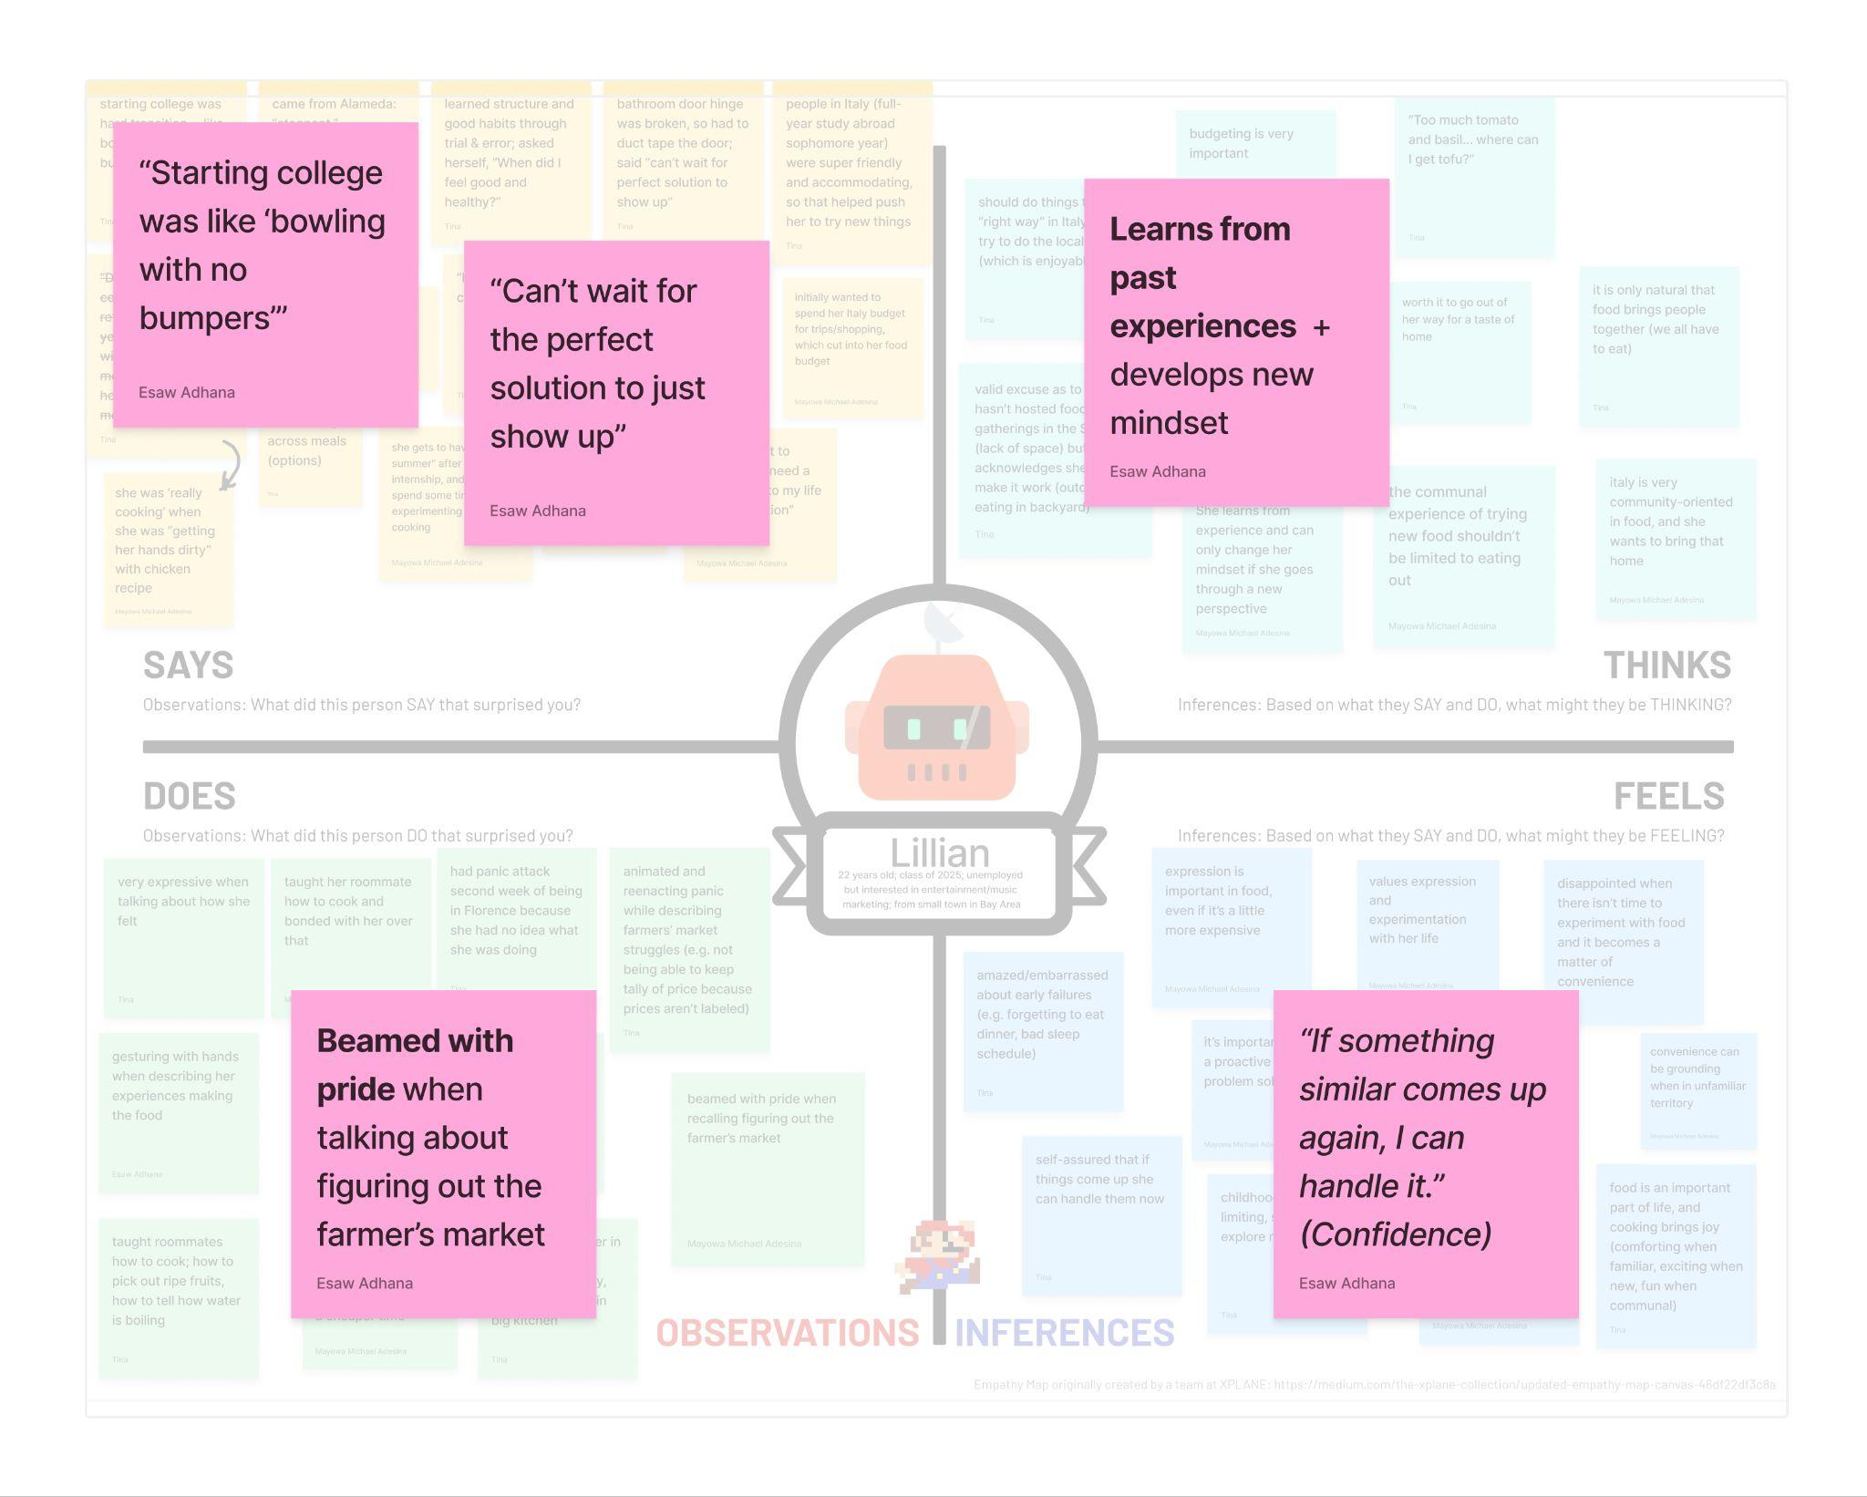

Slide 27
Notes from Lillian
“I’m resistant to change, so I need a big change to my life to cause action.”
Notes:
This quote from Lillian we feel really encapsulates the general tone of her interview well.

Slide 28
Insight:
Lillian values her independence and being able to try new things, even if they don’t go right the first time.

Slide 29
Insight:
Lillian values her independence and being able to try new things, even if they don’t go right the first time.
Need:
People want to try new things/experiment (eg. with food), but don’t want to take big risks (eg. wasting time/money).

Slide 30
Notes:
Now moving to our second interviewee.

Slide 31
Notes from Nora

Slide 32
Notes from Nora
Chose to conduct interview at quiet courtyard on Berkeley campus

Slide 33
Notes from Nora
Chose to conduct interview at quiet courtyard on Berkeley campus
Originally from Oregon (no family in area)

Slide 34
Notes from Nora
Chose to conduct interview at quiet courtyard on Berkeley campus
Originally from Oregon (no family in area)
  Freshman Year was a large transition
    Lived in a dorm on meal plan

Slide 35
Notes from Nora
Chose to conduct interview at quiet courtyard on Berkeley campus
Originally from Oregon (no family in area)
  Freshman Year was a large transition
    Lived in a dorm on meal plan
  Off-campus Sophomore Year
    No meal plan
    Anxious about living alone; cooking alone

Slide 36
Notes from Nora
"I have anxiety… [and had] a weird fear of having to cook for [myself]"

Slide 37
Notes from Nora
Chose to conduct interview at quiet courtyard on Berkeley campus
Originally from Oregon (no family in area)
  Freshman Year was a large transition
    Lived in a dorm on meal plan
  Off-campus Sophomore Year
    No meal plan
    Anxious about living alone; cooking alone
Developed some habits regarding food
  "Definitely [prioritizes] cost"
  Developed budgets or works more to balance $ spent on food
  Purchases bulk foods (rice/pasta) for cost

Slide 38
Notes from Nora
Chose to conduct interview at quiet courtyard on Berkeley campus
Originally from Oregon (no family in area)
  Freshman Year was a large transition
    Lived in a dorm on meal plan
  Off-campus Sophomore Year
    No meal plan
    Anxious about living alone; cooking alone
Developed some habits regarding food
  "Definitely [prioritizes] cost"
  Developed budgets or works more to balance $ spent on food
  Purchases bulk foods (rice/pasta) for cost
Contradiction: Values food they can take/heat up quickly
  Granola bars, snack foods, even if more expensive.

Slide 39
Notes from Nora
Studied abroad in Japan Junior Year
  First time couldn't even contact family
  Described as "first real-year of being an adult"

Slide 40
Notes from Nora
Studied abroad in Japan Junior Year
  First time couldn't even contact family
  Described as "first real-year of being an adult"
Described many "adult issues" shielded from being a university student
  Opening a bank account
  Losing a wallet and canceling a credit card
  Opening a cellphone plan
  Plumbing Issues (no hot water)

Slide 41
Notes from Nora
Studied abroad in Japan Junior Year
  First time couldn't even contact family
  Described as "first real-year of being an adult"
Described many "adult issues" shielded from being a university student
  Opening a bank account
  Losing a wallet and canceling a credit card
  Opening a cellphone plan
  Plumbing Issues (no hot water)
Learned that "If you don't do it, it's not going to happen"
  Wished they could have human-interactions to learn things before they happen.
  When rules are "not explicitly out there… having to learn the rules myself is difficult"

Slide 42
Notes from Nora
(Regarding learning how to adult)
"I wish that there had almost been a big rulebook I could read on how to just adult… better."

Slide 43
Insight:
For a lot of newly transitioned students, it’s hard to feel prepared for the financial burden food can create.

Slide 44
Insight:
For a lot of newly transitioned students, it’s hard to feel prepared for the financial burden food can create.
Need:
People need to feel confident in their financial decisions buying food in order to enjoy food.

Slide 45
Notes:
Now moving to our third interviewee.

Slide 46
Notes from Lucy

Slide 47
Notes from Lucy
Chose to conduct interview in their backyard (at their house in SF)

Slide 48
Notes from Lucy
Chose to conduct interview in their backyard (at their house in SF)
Originally from China, but attended boarding schools and college in US

Slide 49
Notes from Lucy
Chose to conduct interview in their backyard (at their house in SF)
Originally from China, but attended boarding schools and college in US
Currently co-founder of an SF-based startup
  Lives with multiple roommates/coworkers
  Share cooking duties (but no schedule/rotation)

Slide 50
Notes from Lucy
Chose to conduct interview in their backyard (at their house in SF)
Originally from China, but attended boarding schools and college in US
Currently co-founder of an SF-based startup
  Lives with multiple roommates/coworkers
  Share cooking duties (but no schedule/rotation)
Hates Cooking
  Prioritizes (in order): time (including cleanup), taste, then cost
  Orders food frequently
  Sees time spent cooking as time could've been working

Slide 51
Notes from Lucy
Chose to conduct interview in their backyard (at their house in SF)
Originally from China, but attended boarding schools and college in US
Currently co-founder of an SF-based startup
  Lives with multiple roommates/coworkers
  Share cooking duties (but no schedule/rotation)
Hates Cooking
  Prioritizes (in order): time (including cleanup), taste, then cost
  Orders food frequently
  Sees time spent cooking as time could've been working
  Contradiction: Even if time-saving, avoids meal kits
    Why: Removes agency/control
    Cares about agency more than cost

Slide 52
Notes from Lucy
"Adulting is… [dealing with the] many small, annoying things you have to handle."*
* Paraphrased

Slide 53
Insight:
Ordering food or other quick-to-make foods can increase the value of the food, even when sacrificing taste for convenience.

Slide 54
Insight:
Ordering food or other quick-to-make foods can increase the value of the food, even when sacrificing taste for convenience.
Need:
People want to feel agency in their food choices, and that is not always dictated by taste.

Slide 55
Notes:
Now moving onto our fourth and final interviewee.

Slide 56
Notes from Samantha

Slide 57
Notes from Samantha
Chose to conduct interview at the cafe closest to where she lives

Slide 58
Notes from Samantha
Chose to conduct interview at the cafe closest to where she lives
Prioritizes convenience and saving time
  Conceded that money/budgeting isn’t too much of a worry

Slide 59
Notes from Samantha
Chose to conduct interview at the cafe closest to where she lives
Prioritizes convenience and saving time
  Conceded that money/budgeting isn’t too much of a worry
  Enjoys food and agency from cooking for self, but takes a lot of effort

Slide 60
Notes from Samantha
Chose to conduct interview at the cafe closest to where she lives
Prioritizes convenience and saving time
  Conceded that money/budgeting isn’t too much of a worry
  Enjoys food and agency from cooking for self, but takes a lot of effort
Also gets food provided for her at her office
  Started off good, but has started lacking in options

Slide 61
Notes from Samantha
Chose to conduct interview at the cafe closest to where she lives
Prioritizes convenience and saving time
  Conceded that money/budgeting isn’t too much of a worry
  Enjoys food and agency from cooking for self, but takes a lot of effort
Also gets food provided for her at her office
  Started off good, but has started lacking in options
  Contradiction: Enjoys complexity in food given to her in the office, but is okay with simple recipes when she’s cooking for herself

Slide 62
Notes from Samantha
Chose to conduct interview at the cafe closest to where she lives
Prioritizes convenience and saving time
  Conceded that money/budgeting isn’t too much of a worry
  Enjoys food and agency from cooking for self, but takes a lot of effort
Also gets food provided for her at her office
  Started off good, but has started lacking in options
  Contradiction: Enjoys complexity in food given to her in the office, but is okay with simple recipes when she’s cooking for herself
Sticks to eating out/going grocery shopping at places near her
  Found a few places that fit what she likes initially and has stuck to them
  Awkward/inconvenient for her to get food at different places

Slide 63
Notes from Samantha
“Cooking takes a LOT of time — getting groceries, cooking, cleaning, washing dishes, storing food — it adds up.” *
* Paraphrased

Slide 64
Insight:
Eaters with specific tastes can be isolated by meals or groceries they don’t have control over.

Slide 65
Insight:
Eaters with specific tastes can be isolated by meals or groceries they don’t have control over.
Need:
Adults need access to food information that is reliable and constant, so they can make individual choices.

Slide 66
Connections, Observations, Findings (Further Analysis)
Our interviewees have systems that work… BUT
  Potentially unideal
    Relying on convenient / “easy” options
    Describe inability to explore as much as they would like
“Trial by fire”
  Only way to learn/figure out what works is by first learning what doesn’t
  Often lacked resources/ability to learn this in safe, controlled environments
Enjoy their autonomy (and doing pretty well for themselves)
  (Don’t need a full-180° transformation!)

Slide 67
Connections, Observations, Findings (Further Analysis)
Our interviewees have systems that work… BUT
  Potentially unideal
    Relying on convenient / “easy” options
    Describe inability to explore as much as they would like
“Trial by fire”
  Only way to learn/figure out what works is by first learning what doesn’t
  Often lacked resources/ability to learn this in safe, controlled environments
Enjoy their autonomy (and doing pretty well for themselves)
  (Don’t need a full-180° transformation!)

Slide 68
Connections, Observations, Findings (Further Analysis)
Our interviewees have systems that work… BUT
  Potentially unideal
    Relying on convenient / “easy” options
    Describe inability to explore as much as they would like
“Trial by fire”
  Only way to learn/figure out what works is by first learning what doesn’t
  Often lacked resources/ability to learn this in safe, controlled environments
Enjoy their autonomy (and doing pretty well for themselves)
  (Don’t need a full-180° transformation!)

Slide 69
Connections, Observations, Findings (Further Analysis)
Our interviewees have systems that work… BUT
  Potentially unideal
    Relying on convenient / “easy” options
    Describe inability to explore as much as they would like
“Trial by fire”
  Only way to learn/figure out what works is by first learning what doesn’t
  Often lacked resources/ability to learn this in safe, controlled environments
Enjoy their autonomy (and doing pretty well for themselves)
  (Don’t need a full-180° transformation!)

Slide 70
Connections, Observations, Findings (Further Analysis)
Our interviewees have systems that work… BUT
  Potentially unideal
    Relying on convenient / “easy” options
    Describe inability to explore as much as they would like
“Trial by fire”
  Only way to learn/figure out what works is by first learning what doesn’t
  Often lacked resources/ability to learn this in safe, controlled environments
Enjoy their autonomy (and doing pretty well for themselves)
  (Don’t need a full-180° transformation!)

Slide 71
Connections, Observations, Findings (Further Analysis)
Our interviewees have systems that work… BUT
  Potentially unideal
    Relying on convenient / “easy” options
    Describe inability to explore as much as they would like
“Trial by fire”
  Only way to learn/figure out what works is by first learning what doesn’t
  Often lacked resources/ability to learn this in safe, controlled environments
Enjoy their autonomy (and doing pretty well for themselves)
  (Don’t need a full-180° transformation!)

Slide 72
What’s next?

Slide 73
What’s next?
Interviewees are willing to try new things within reason
  Anything we create for them should ideally feel easy/seamless

Slide 74
What’s next?
Interviewees are willing to try new things within reason
  Anything we create for them should ideally feel easy/seamless
Interviewees focused on idea of “struggle at first, then adapt”

Slide 75
What’s next?
Interviewees are willing to try new things within reason
  Anything we create for them should ideally feel easy/seamless
Interviewees focused on idea of “struggle at first, then adapt”
  Potential A2 interview questions:
    “Describe an experience while living independently where you handled a difficult problem. Would you have done anything differently?”
    “When you have questions about navigating living independently, how do you seek answers (ie. from who/what resources)?”

Slide 76
Questions?
Mayowa Adesina
(mayowa13@)
Esaw
Adhana
(eadhana@)
Butch
Nasser
(ban@)
Tina
Zheng
(zhengti@)

Slide 77
Appendix

Slide 78
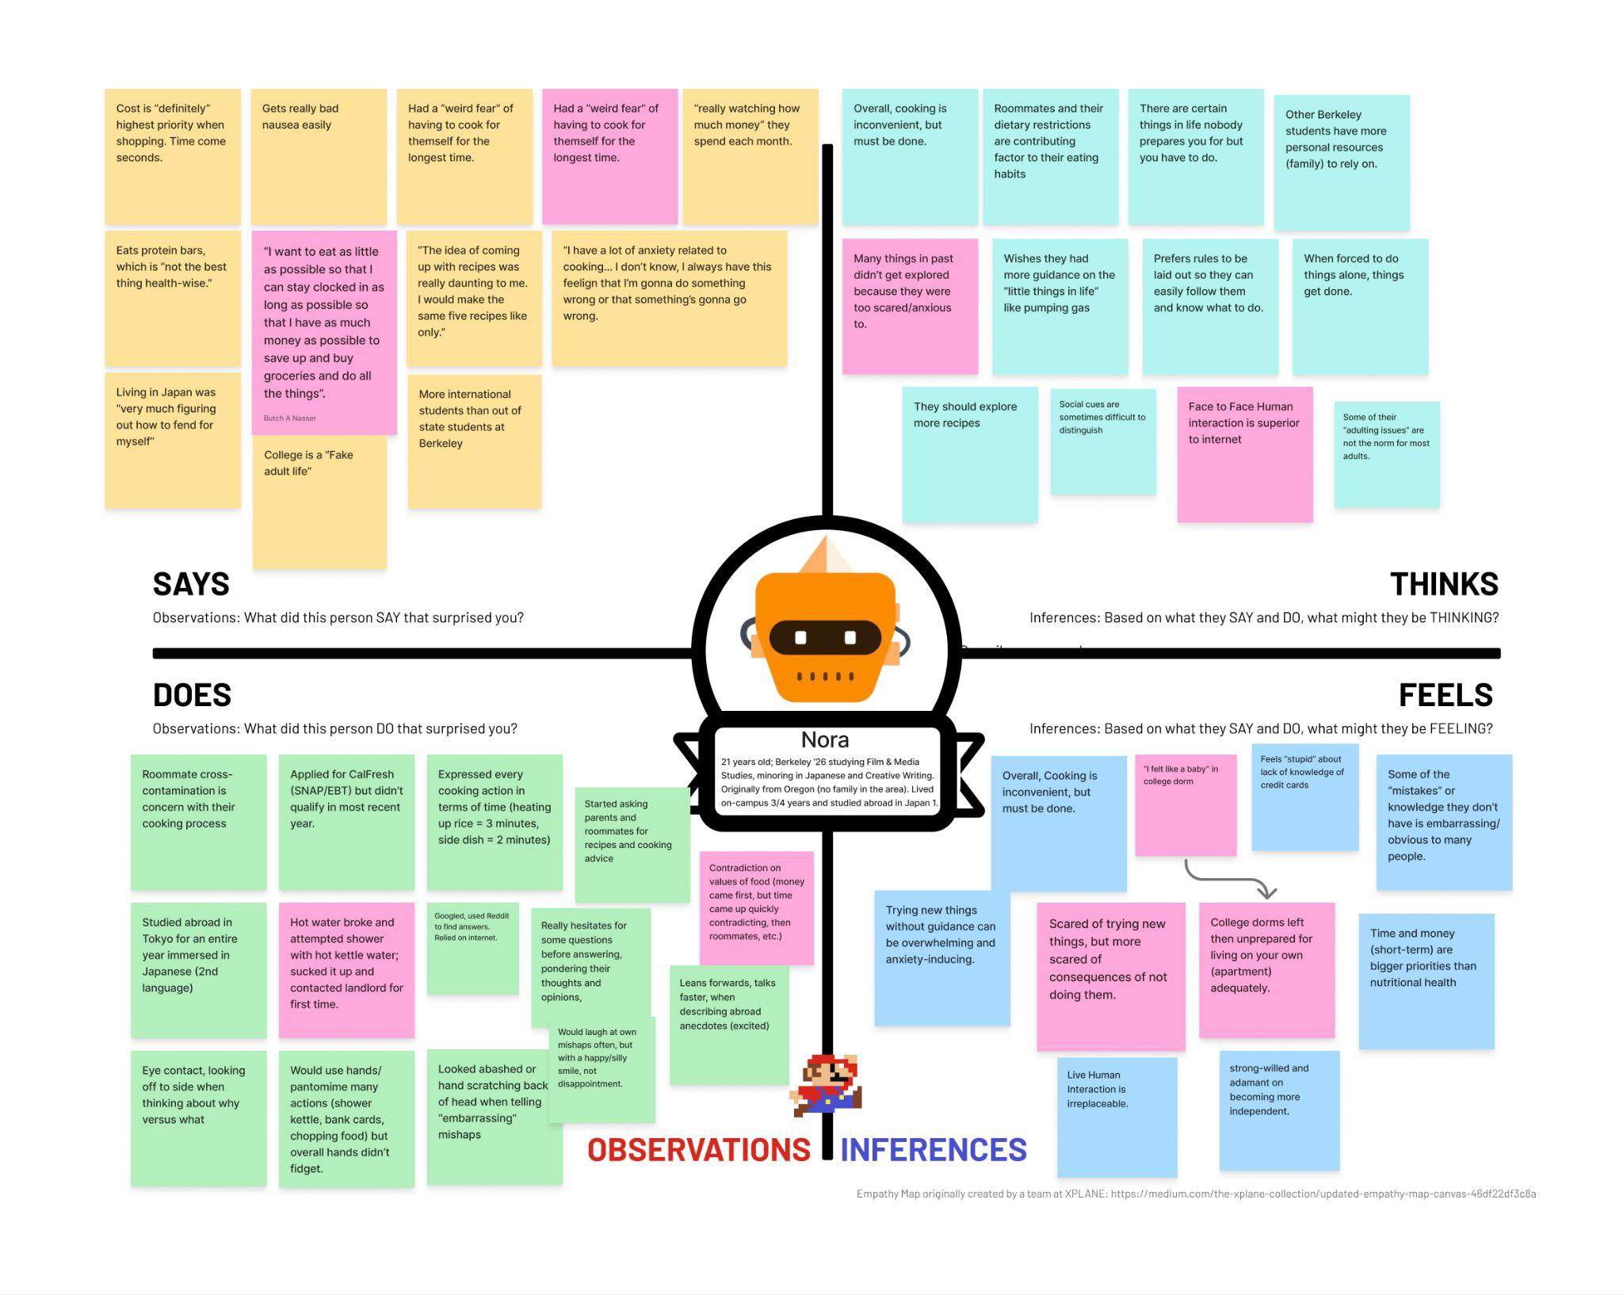
Notes:
Pink sticky notes are our highlighted/”key” ideas.

Slide 79
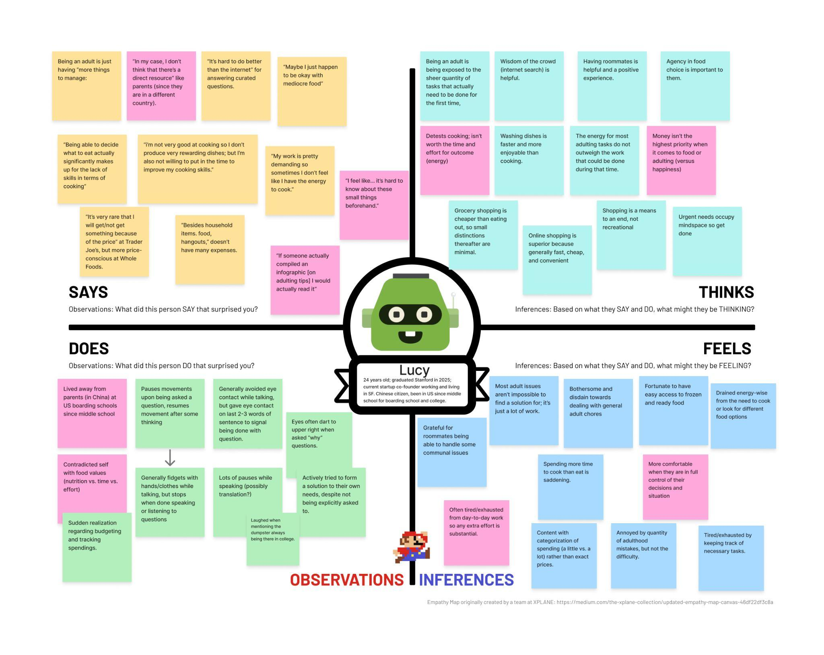
Notes:
Pink sticky notes are our highlighted/”key” ideas.

Slide 80
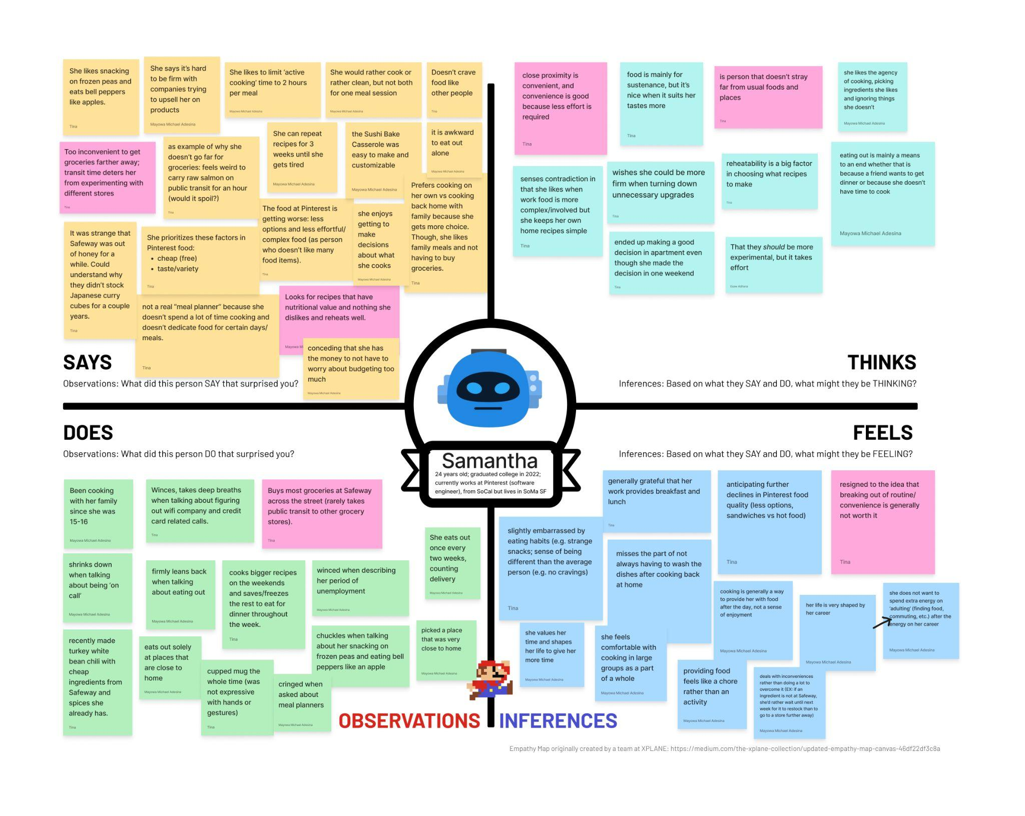
Notes:
Pink sticky notes are our highlighted/”key” ideas.
Samantha graduated from Rice in 3 years.

Slide 81
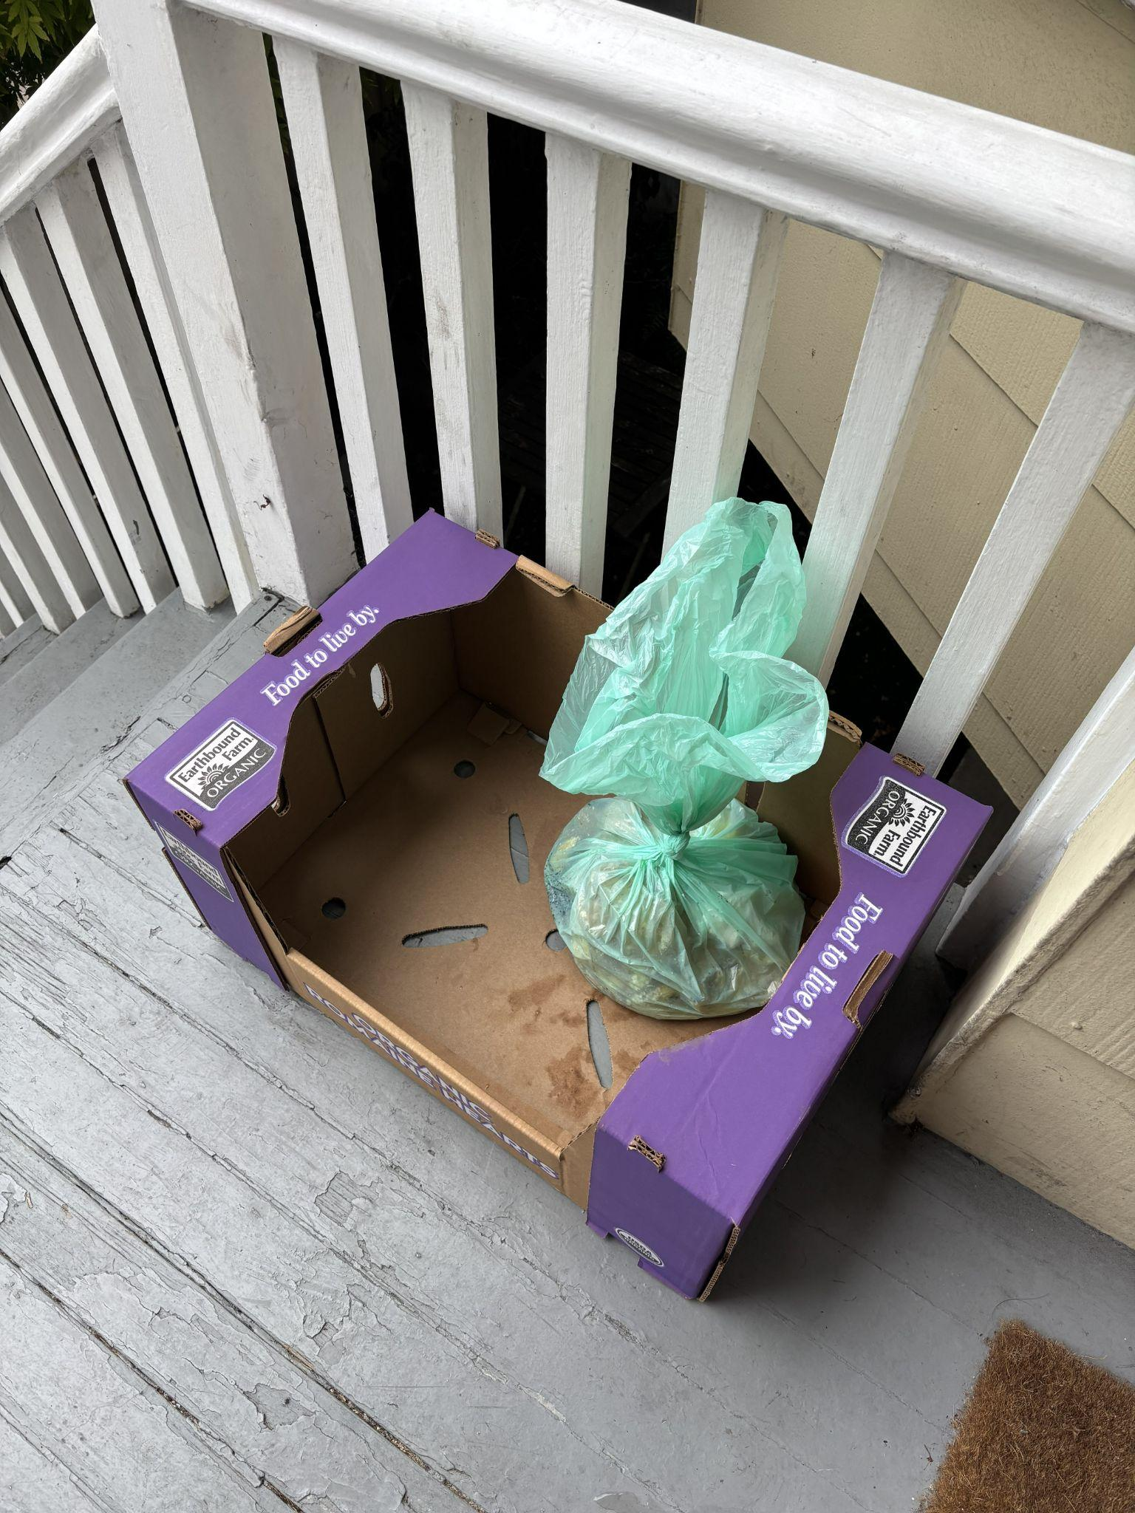
Artifact - Lucy and compost bin going missing
Notes:
Lucy mentioned that her compost bin went missing (taken by accident or purpose, she is unsure), and thus it required her to be a little crafty while waiting for a replacement)

Slide 82
Appendix
Lillian:
Told story about how while studying abroad in Italy, she had a panic attack second week in because she went to a farmer’s market and had no idea what she was doing. As someone who was living on a budget, it was stressful that she couldn’t tell while picking things out the prices and couldn’t keep tally of the total cost and didn’t want to keep asking. Also feared she would be overcharged, but the vendors turned out to be very friendly and accommodating.
Realization: She fondly reminisced about inviting friends over to her big kitchen in Italy to make communal Italian food with local ingredients. She then realized she hasn’t really done that since and wants to bring that back (though her apartment has a small kitchen). Thus, the community aspect of food/cooking is important to her. “It’s only natural that it brings people together.”
Realization: Taught her roommates how to cook and realized what she thought was common sense wasn’t always the case. “How do I tell when water is boiling?” “How do I tell if an avocado is ripe?”
Interesting how she described that she ping-pongs from comfort and discomfort: “Taste of home” vs “experimentation and exploration of food”; example: while in Italy, she loved trying new local pastas but eventually went out of her way to find tofu (food of her childhood); variety across meals is important to her
Emphasized that when her apartment bathroom door was coming off its hinges, you just “can’t wait” for a perfect fix; thus, she had it duct taped for a while; she feels confident that she can figure out any problem.

Slide 83
Appendix
Samantha:
Realization: she talked about making a salmon sushi bake/casserole recipe she really likes before (how it was easy to prepare and very customizable) but realized she hasn’t made it in a while (potentially because it doesn’t reheat well)
Described process of making turkey white bean chili: walk across the street to Safeway (with list of ingredients), buy can of white beans, can of diced tomatoes, pack of ground turkey; other spices are already at home; very simple to make because you only need to chop one thing (onion) and you can leave it be while it simmers (not much active cooking time). Additionally, it reheats well (she is keeping extra portions in her freezer right now for future dinners).
described

